Slide 1

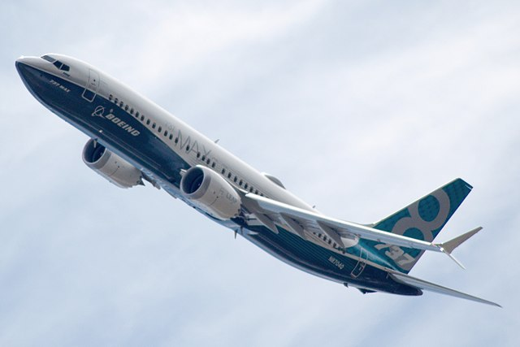

Boeing’s Fatal Mistake: The Groundings of 737 MAX 8 in 2019
Nguyen Minh Tuan, School of Electronics and Electrical Engineering, Hanoi University of Science and Technology.
Instructor: PhD. Hoang Phuong Chi
Hanoi, December 15th, 2023

Slide 2
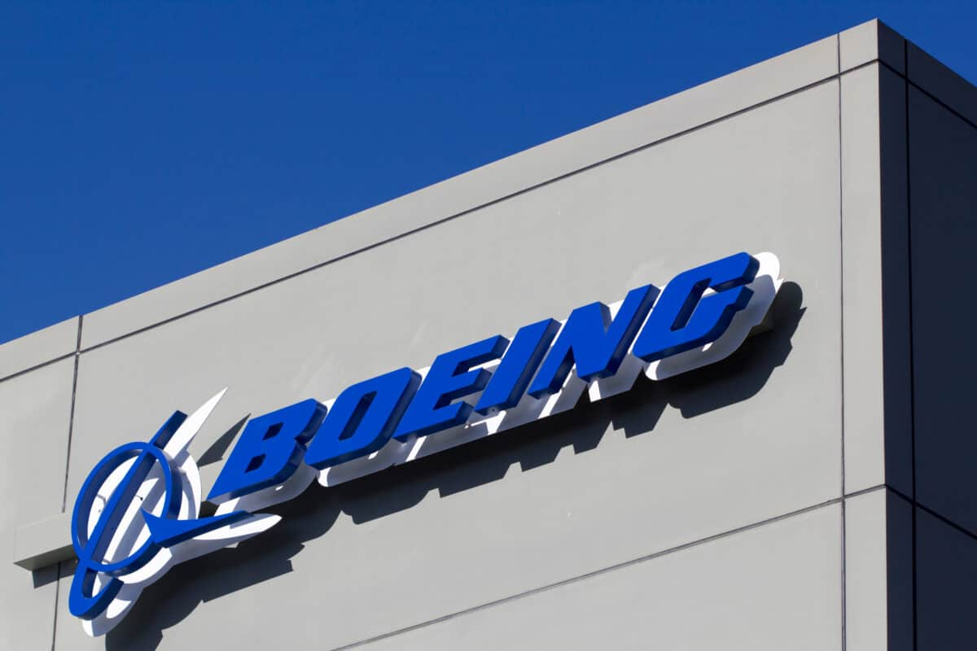

Table of Contents
Two consecutive crashes
The fierce rivalry
What can we learn from the case?

Slide 3
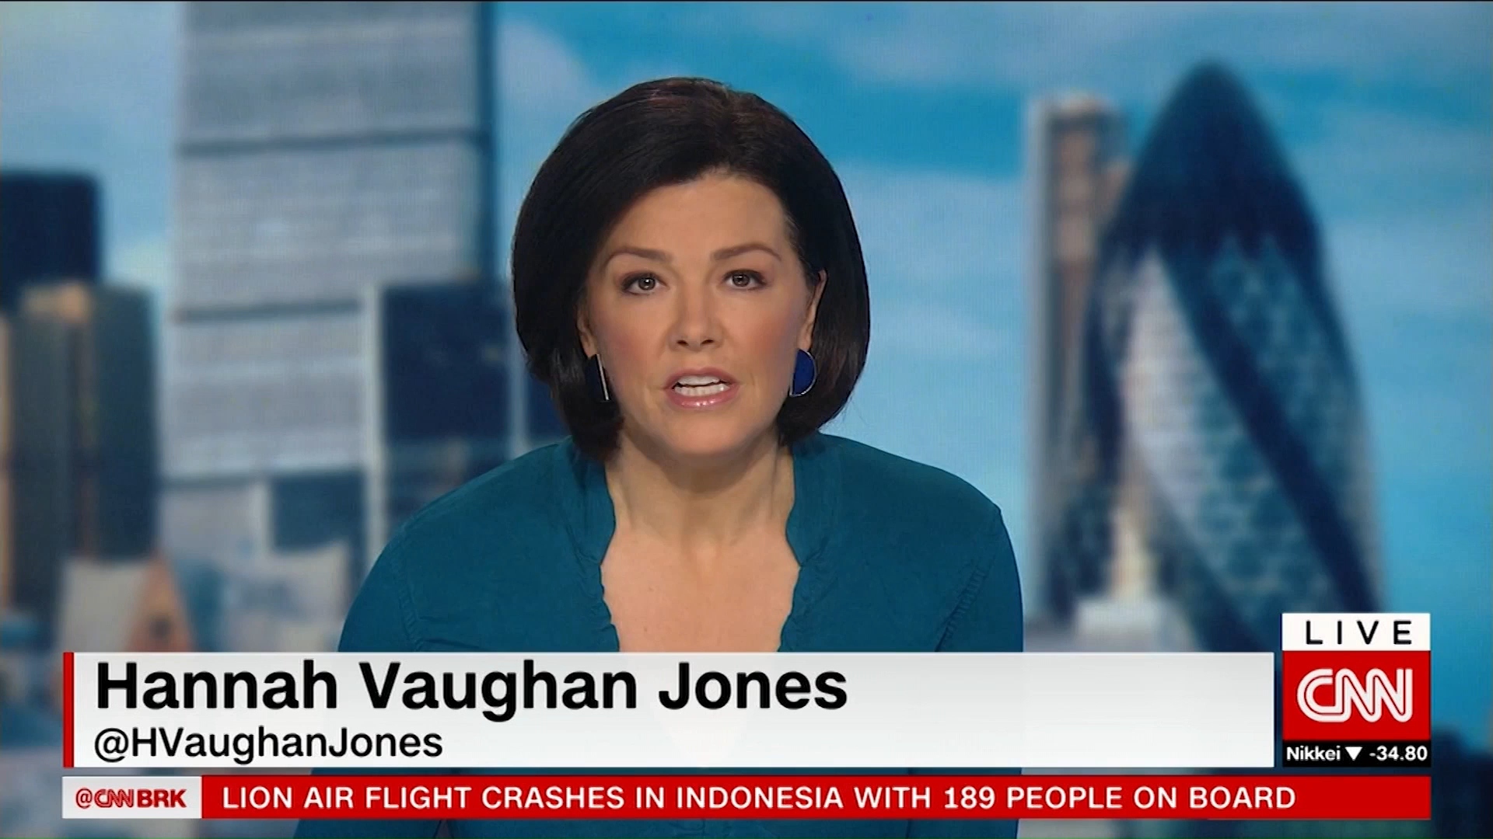
I, Two Consecutive Crashes
1, Lion Air Flight 610
On October 29th, 2018, Lion Air Flight 610 took off from Soekarno-Hatta International Airport, Jakarta for a domestic flight to Depati Amir Airport, Pangkal Pinang, Indonesia. 13 minutes after departure, the aircraft that was operating the route crashed into the Java Sea, killing all 189 passengers and crew members on board.
* Aircraft: Boeing 737 MAX 8 (PK-LQP) with 2x CFM International LEAP-1B
* Crew members:
+ Captain: Bhavye Suneja
+ First Officer: Harvino

Slide 4
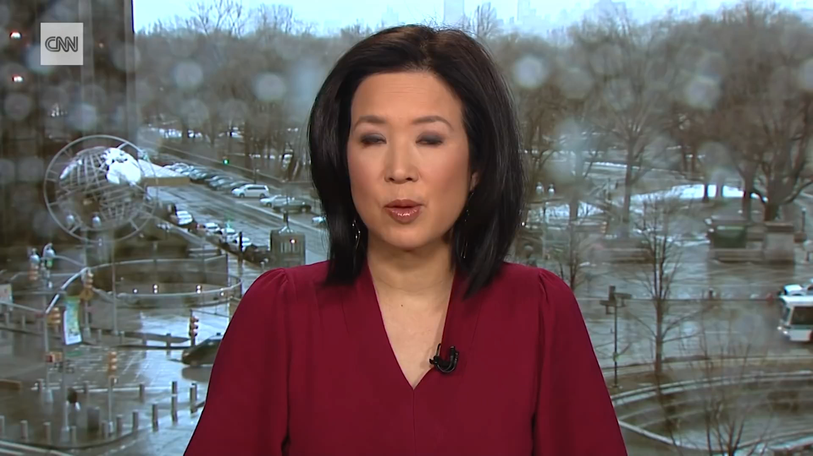
I, Two Consecutive Crashes
2, Ethiopian Airlines Flight 302
Ethiopian Airlines Flight 302 is a scheduled international flight from Bole International Airport, Addis Ababa, Ethiopia to Jono Kenyatta International Airport, Nairobi, Kenya. On March 10th, 2019, the aircraft that was operating the route crashed near the town of Bishoftu, Ethiopia 6 minutes after taking off, killing all 157 passengers and crew members on board.
* Aircraft: Boeing 737 MAX 8 (ET-AVJ) with 2x CFM International LEAP-1B
* Crew members:
+ Captain: Yared Getachew
+ First Officer: Ahmed Nur Mohammad Nur

Slide 5
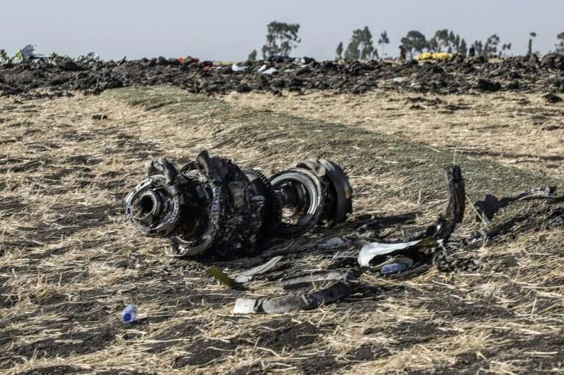
I, Two Consecutive Crashes
Two crashes, the same aircraft, same engine, in less than 5 months. The fastest selling jet in Boeing history, just introduced the year before. 346 people killed. An iconic American company’s reputation in tatters. The story of the 737 MAX would “end up exposing corporate deception and a broken regulatory process”. But at the center was a problematic software system supposed to keep people safe that instead – led to their deaths.
PBS Frontline – Boeing’s Fatal Flaw

Slide 6
II, The fierce rivalry
1
2
3
4
5
Airbus and Boeing market share
Boeing pulled the trigger on releasing the 737 MAX
CFM International LEAP-1B
A problematic system
Concealing became killing

Slide 7
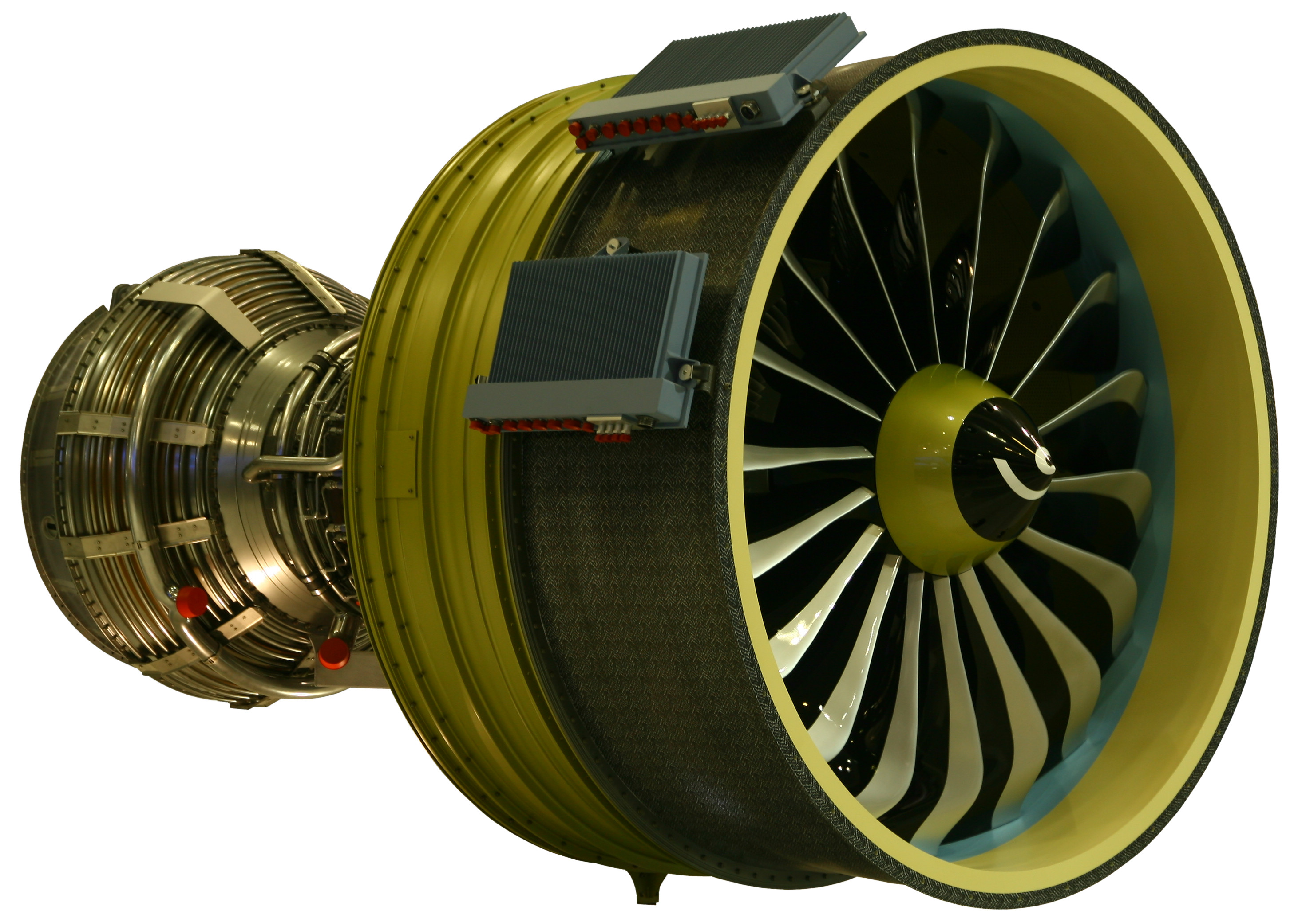

1, Airbus and Boeing Market Share
Boeing and Airbus have long been the two biggest aircraft manufacturer in aviation. According to Vox, they have a market share of 38% and 28% respectively. If one could offer a better aircraft, the other one could lose a lot of money. And that was what happened in the 2011 Paris Air Show.
Airbus updated their most successful single-aisle aircraft, the A320 with a new engine that is 15% more fuel efficient. Also, it requires minimal pilot training. They slide in the new CFM International LEAP-1A. And this placed enormous pressure on Boeing. For the first time in a decade, American Airlines is not going to use Boeing’s aircraft.
“And that is essentially a dagger in the heart of Boeing” (Natalie Kitroeff, New York Times Reporter, PBS Frontline’s Documentary “Boeing’s Fatal Flaw”)

Slide 8
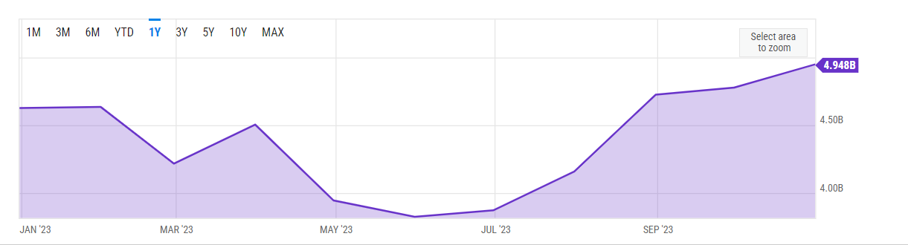
2, Boeing pulled the trigger on releasing the 737 MAX
The releasing of the A320 NEO placed enormous pressure on Boeing. It was such a good and attractive aircraft since it saves airlines millions of dollars every single year. According to YCharts, US Airline Fuel Cost is 4.948 billion USD. 15% of this amount equals 742.2 million USD – which is, such an amount of money.
Boeing was looking on the 737 MAX program to restore their own credibility after being over budgeted on their 787 program and the 747-8 program.

Slide 9




*What Boeing need to achieve
15% or more fuel-efficient
Minimal pilot training
New engine, yet still operating the same as its predecessor

Slide 10
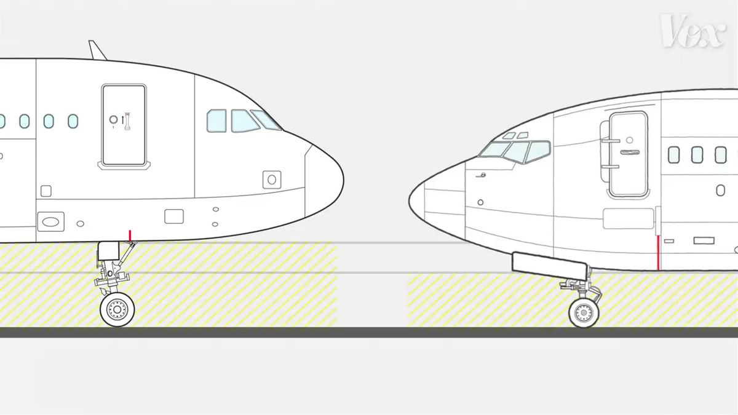
3, CFM International LEAP-1B
Boeing decided to use a similar engine to the A320 NEO – which is the CFM International LEAP-1B. This engine is bigger to make it much more fuel-efficient. But some problems arised…

Slide 11
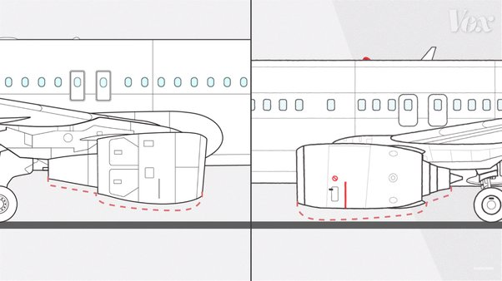
3, CFM International LEAP-1B
This is the sketch of the CFM International LEAP-1B, comparing to the old engines.

Slide 12
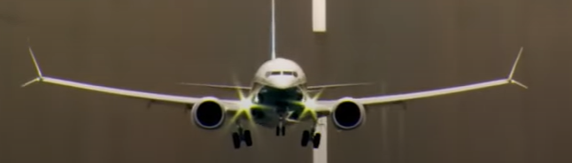
*Boeing’s solution to the problem
Their solution was to move the engine up and mount it further forward.

Slide 13
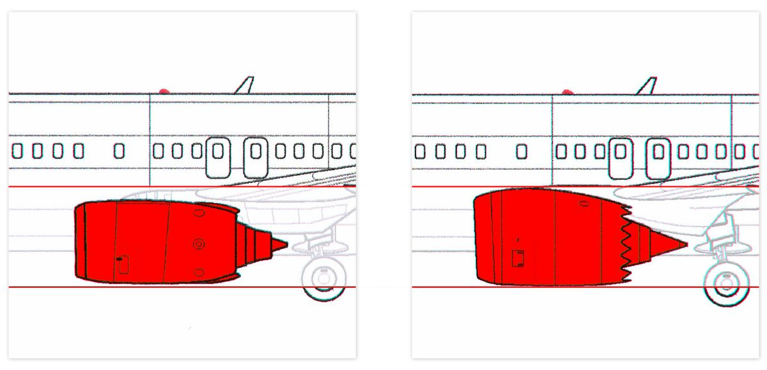
*Boeing’s solution to the problem
Their solution was to move the engine up and mount it further forward.

Slide 14
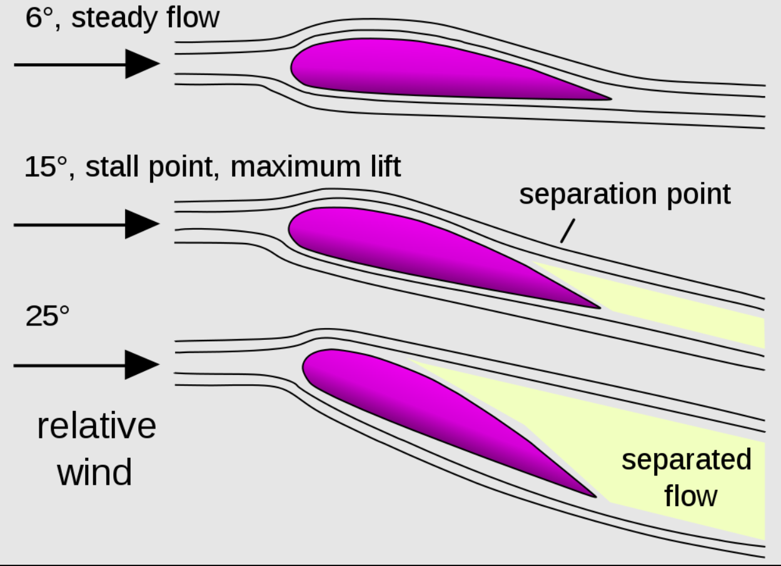
4, A problematic system
Because of the design, the 737 MAX has a backward balance point, which leads to a higher nose pitch, exceeding the critical angle-of-attack, which leads to a stall situation.
A stall situation occurs when the angle-of-attack is so high that is exceeds the critical angle-of-attack, thus separating the airflow which results in a loss of lift coefficient that would make the plane fall out of the sky.
*Thất tốc (Stall): là tình trạng góc tấn vượt quá góc tấn giới hạn dẫn tới việc chia tách dòng khí, từ đó gây ra hiện tượng mất lực nâng và gây tròng trành, có thể dẫn tới việc rơi máy bay.

Slide 15
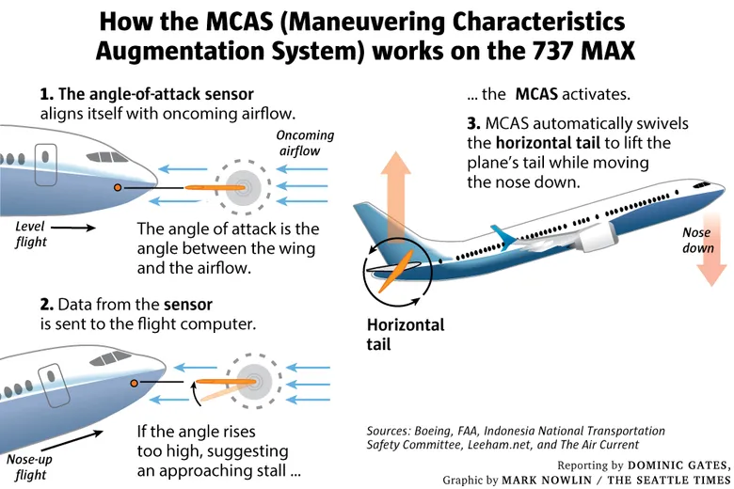
4, A problematic system
Boeing has to rely on a system that they have previously used on the KC-46 Pegasus military tanker. It was designed to smooth out the way the plane handle. It was called the Maneuvering Characteristic Augmentation System (MCAS). Its mission was to take input data from the AoA Sensors and push the nose down by moving the horizontal stabilizer up when it believes that the plane might go into a stall.

Slide 16
4, A problematic system
In the beginning, it was designed to be activated during a full thrust situation. But it was not until the test flight did Boeing noticed that the MAX need MCAS even in low-speed situations. They have to expand the way MCAS works. So they made 2 critical changes:
1, They made MCAS much more powerful
2, MCAS relies on only one angle-of-attack sensor to decrease reaction time.
These changes make MCAS a very safety-critical system.

Slide 17
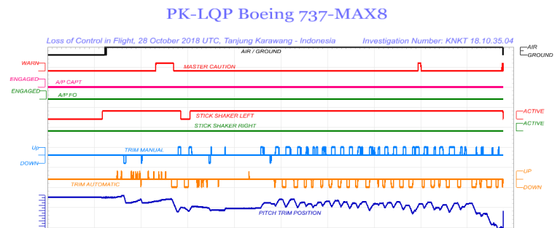
*Lion Air Flight 610 Flight Data
The flight data from Lion Air Flight 610 shows what appears to be a glitch. The plane was continuously trying to push the nose down.

Slide 18
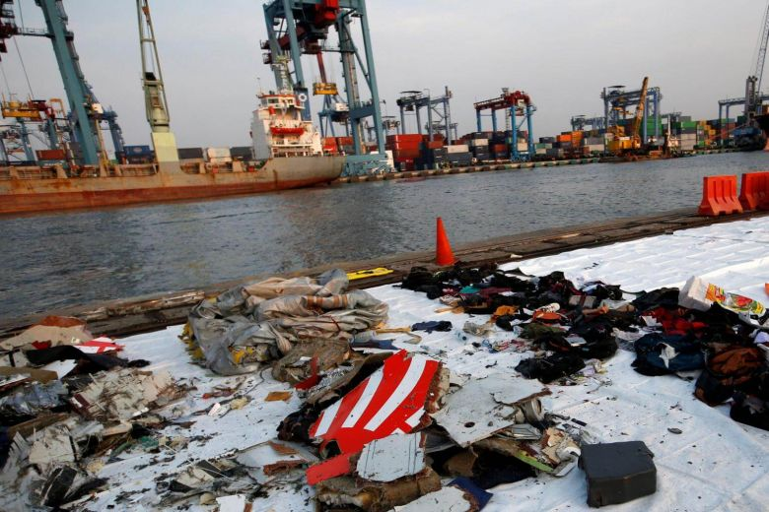
5, Concealing became killing
In an email, Lion Air request for additional pilot training in order to fly the 737 MAX. Boeing’s response was to denied the request: “There is absolutely no reason to require your pilots to have a MAX simulator training to begin flying the MAX”. But Boeing knew that there was a monster waiting for the pilots. Sadly, Lion Air 610’s pilot aren’t from Boeing…
“And the pilot never understood that it was trying to kill them” (Capt. Chesley “Sully” Sullenberger, Netflix’s Documentary “Downfall: The Case Against Boeing”).

Slide 19
III, What can we learn from the case?
This story ended up exposing corporate deception and a broken regulatory process. This is what happens when you put financial profit as the number one priority in any project and put aside human safety.

Slide 20
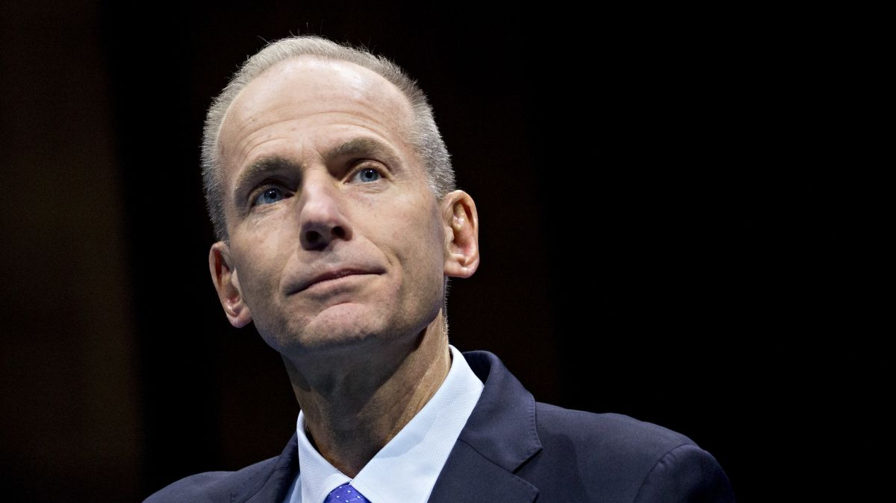
*Some facts on the case
- The Boeing 737 MAX was the first aircraft to be grounded by the President of US (at that time, Donald Trump)
- Boeing ended up losing 2.2 billion dollars on this case
- It led to the testimony of Dennis Muilenburg, CEO of Boeing in front of the US Congress. 2 months after the testimony, Dennis Muilenburg resigned as the CEO of Boeing after being criticized by the mistake of the 737 MAX. Replacing him was David Calhoun.

Slide 21






Quote of the case
“It was their greed. Are the profits more important than the human life?”
~ Garima Sethi, Bhavye Suneja’s wife

Slide 22



This Presentation is Prepared by
Nguyen Minh Tuan
Big thanks to PhD. Hoang Phuong Chi for supporting me throughout the whole subject and in finishing this topic.
Thank you for those who supported me in finishing this report.

